Slide 1
Papyrus
Isabelle Egan 2015

Slide 2
Old glass is brittle and becomes a danger

Slide 3
Rehousing recto verso visible.
Simpler and lighter housing

Slide 4
.
…

Slide 6
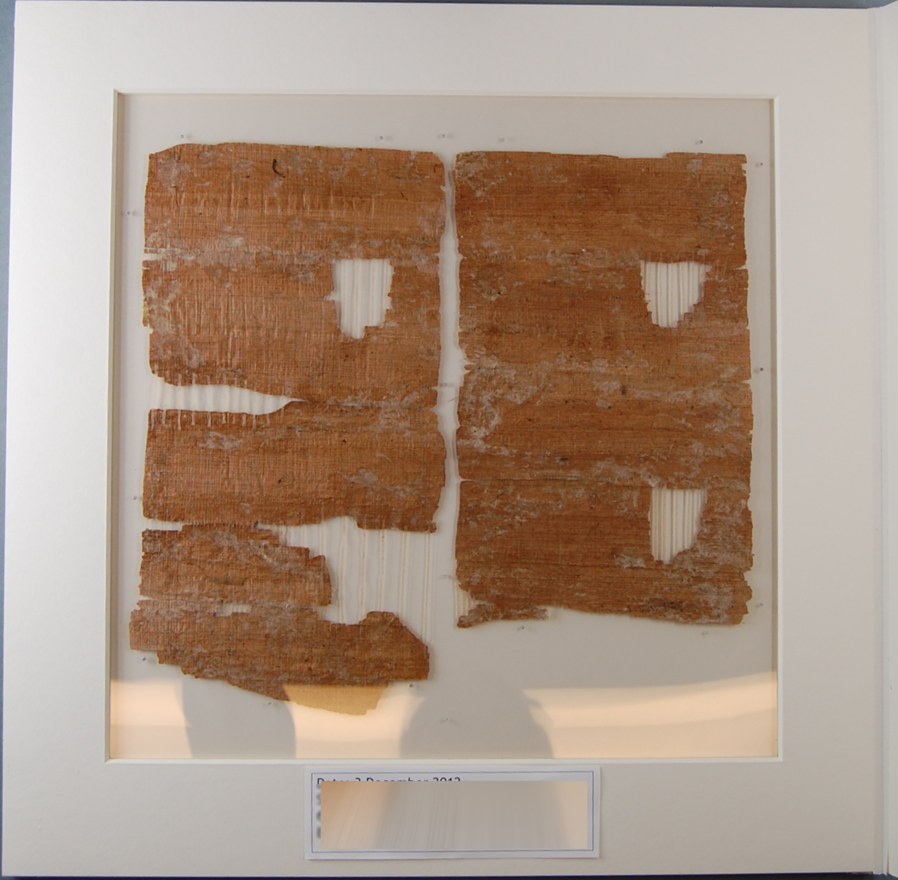
Repairs on verso of a papyrus

